Slide 1

Project ID: PCS25-19 Prediction of TEC variations with Artificial Intelligence using Space Weather Data as input
Project Members: Ananya Srivastava (2100290120028)
Aryan Kaushik (2200290129006)
Manas Rai (2100290120100)
Guide Name: Dr. Harsh Khatter (Associate Professor)

Slide 2
Problem Statement
The ionospheric electron density is sensitive to the space weather parameters and shows variation with respect to them
The information about these parameters are available before they actually influence the terrestrial ionosphere
These parameters affect the ionospheric Total Electron Count(TEC), which in turn shows abrupt variations and deviations from the nominal characteristics
The performance of the GNSS system is also affected by the ionospheric variabilities
Prediction of the TEC provides a handle to take necessary actions to avoid or mitigate the resultant impairments
Once trained, the AI based algorithm may predict the expected TEC variations which can be used by the concerned users
Refer SS612 at https://sih.gov.in/sih2022PS

Slide 3
Project Goals and Objectives
To prepare a web based interface to visualize the continuous trends in variations of TEC (total electron content) as detected by GNSS (global navigation satellite systems).
To prepare a dataset (from satellite data) comprising of various features affecting the TEC
value in the ionosphere.
To train an effective machine learning model on data to detect sudden anomaly in TEC change during solar storms or heavy magnetic solar winds.
To have an effective alert generation module in case any threat is detected also integrating it with backend and the backing it with AI model.

Slide 4
Technology Used ML Models Used
Streamlit Community Cloud
Python
VS Code Editor
Machine Learning
Scikit-Learn
NumPy
Pandas
TensorFlow
Neural Prophet
Designed for time-series forecasting
Captures seasonal, trend, and cyclic patterns in TEC data.
Handles missing values well and adapts to dynamic changes in ionospheric conditions.
Linear Regression
Simple yet effective for TEC trend prediction over short periods.
Works well when TEC variations have a linear pattern with time.
Computationally efficient and easy to implement in real-time applications.

Slide 5
Literature Survey
PREDICTION OF TEC VARIATION USING SPACE WEATHER DATA AND AI (Authors: Tharun Racharla, Sakshi Rajurkar, Saurabh Sakharkar, Aman Mishra, Sarvesh Warjurkar )
Ionospheric TEC Prediction Performance of ARIMA and LSTM Methods in Different Space Weather Conditions (Author: Erman Şentürk)
Ionospheric TEC Prediction Performance of ARIMA and LSTM Methods in Different Space Weather Conditions (Author: Erman Şentürk)
TEC MEASUREMENTS WITH GPS DATA (Ivan J. Kantor, Eurico R. de Paula, Luiz Felipe C. de Rezende)
A Machine Learning-Based Method for Modelling TEC Regional Temporal-Spatial Map (by Yiran Liu, Jian Wang, Cheng Yang, Yu Zheng, Haipeng Fu)

Slide 6
Ionospheric TEC Prediction Performance of ARIMA and LSTM Methods in Different Space Weather Conditions (Author: Erman Şentürk)
This study examines the performance of artificial intelligence (AI) techniques, including machine learning-based methods like ARIMA and long short-term memory (LSTM) networks, in predicting Total Electron Content (TEC) values. The ionosphere is a three-dimensional dispersive medium atmosphere layer above Earth's surface, containing molecules with potential for photoionization. TEC values have periodic temporal and spatial variations due to space weather events such as solar winds, geomagnetic storms, earthquakes, volcanic eruptions, hurricanes/typhoons, and anthropogenic events. Traditional time series analysis methods are not adequate for simulating previous TEC observations, so AI algorithms like ARIMA and LSTM can successfully forecast TEC values for a short period. The study compares the advantages and disadvantages of ARIMA and LSTM methods for ionospheric TEC forecasting. The TEC time series was obtained from the Center for Orbit Determination in Europe – Global Ionosphere Maps (CODE-GIMs) and used for two-time intervals for quiet space weather and a geomagnetic storm.
Time series data, such as TEC variation, is influenced by previous observations rather than independent variables. Traditional Artificial Neural Networks (ANN) can capture irregularities but struggle with vanishing gradients, a problem known as vanishing gradient. LSTM-RNN networks overcome this issue by keeping learning within the network and forecasting based on it. The study splits the dataset into training and test parts, analyzing quiet space weather and geomagnetic storm periods. The results showed quiet space weather for ionospheric variation except for a moderate geomagnetic storm on April 20, 2020. The ARIMA and LSTM models had accuracy of 2.24 and 1.43 TECU, respectively, for quiet space weather and geomagnetic storm periods, respectively.

Slide 7
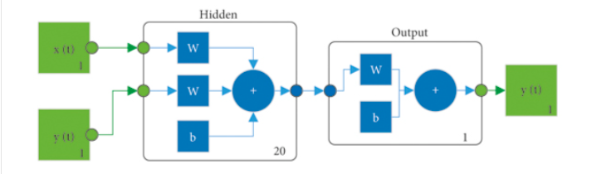
Prediction of Ionospheric TEC Based on the NARX Neural Network (Authors: Liu Guoyan, Gao Wang, Zhang Zhengxie, and Zhao Qing)
This paper presents an ionospheric total electron content (TEC) prediction method using the nonlinear autoregressive with exogenous input (NARX) neural network. The method uses previous TEC data and external time parameter inputs to establish a prediction model. 12 datasets of 3 stations with different latitudes are used for experiments, with each dataset using the first 120 days for training and the next 20 days for testing. The results show that the NARX network can improve TEC prediction accuracy by 32.3% and 43.5% in the year with active solar activity (2011) and 20.7% and 22.7% in the year with calm solar activity (2017). The ionosphere, located 60-1000 km from Earth's surface, is ionized by atmospheric molecules due to solar radiation and cosmic rays. The paper uses the International GNSS Service (IGS) TEC map as the ionospheric prediction target, interpolating TEC at any point and forming a single-point TEC time series. This paper proposes a TEC prediction method using the NARX network, which processes TEC information as a time series based on ionosphere changes. The method uses data from IGS ionospheric grid products and raw observations of GNSS receivers. The NARX algorithm has the highest accuracy in TEC predictions, with RMSEs between 1.501 TECU and 3.722 TECU in 2011 and 1.049 TECU and 2.728 TECU in 2017.

Slide 8
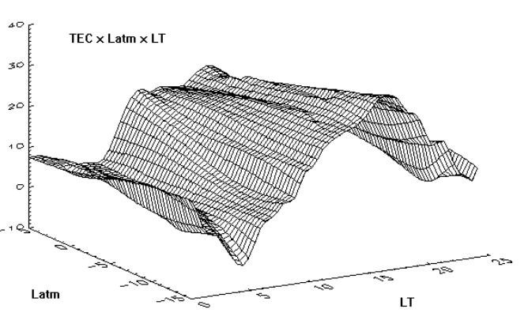
TEC MEASUREMENTS WITH GPS DATA (Ivan J. Kantor, Eurico R. de Paula, Luiz Felipe C. de Rezende)
The Total Electron Content (TEC) is a crucial geophysical parameter used to correct navigation measurements for single frequency receivers. It is measured using the Faraday Rotation effect on a linear polarized propagating plane wave. GPS data is used for TEC measurements, providing at least 4 and up to 9 TEC values within 1000 km of the receiving station every 30 seconds. The Global Positioning System (GPS) is a complex and expensive constellation of 24 satellites distributed in 6 orbital planes, with an orbit inclination of 55 degrees and a 12-hour period. The carrier phase observations have sometimes a sudden jump, that is removed ("cycle slip correction") by adjusting the continuity of (Φ1 - Φ2). This can be done by adjusting a polynomial to some data before and after the cycle slip occurrence.

Slide 9
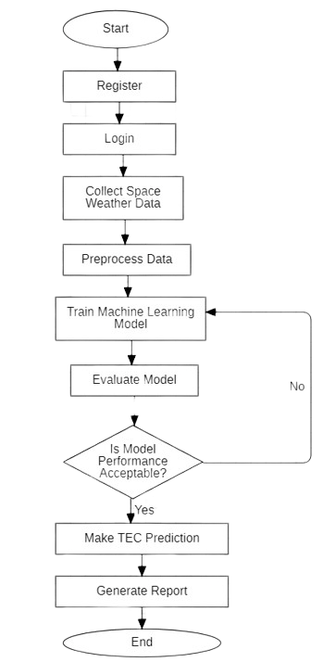
Workflow Diagram

Slide 10
Alignment with UN Sustainable Development Goals (SDGs)
SDG 9: Industry, Innovation, and Infrastructure
Enhances infrastructure reliability through improved satellite communication and navigation systems.
SDG 13: Climate Action
Supports understanding and mitigation of space weather impacts on the environment and technology.
SDG 4: Quality Education
Promotes research and innovation in geospatial and environmental sciences for academic growth.
SDG 17: Partnerships for the Goals
Encourages collaboration between research institutions and industries to advance space weather forecasting.
SDG 7: Affordable and Clean Energy
Contributes to energy efficiency by ensuring uninterrupted satellite-based energy grid monitoring.

Slide 11
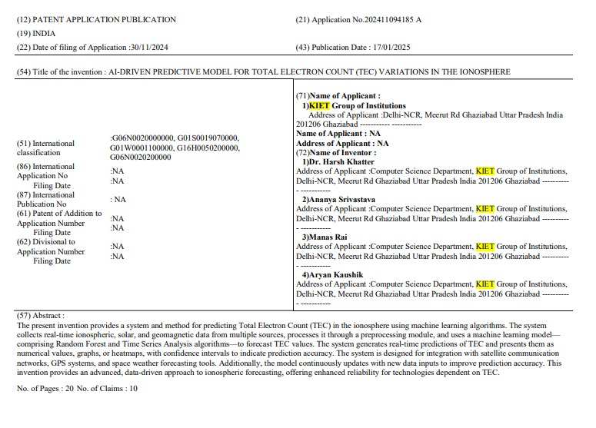
Patent Status: Published

Slide 12
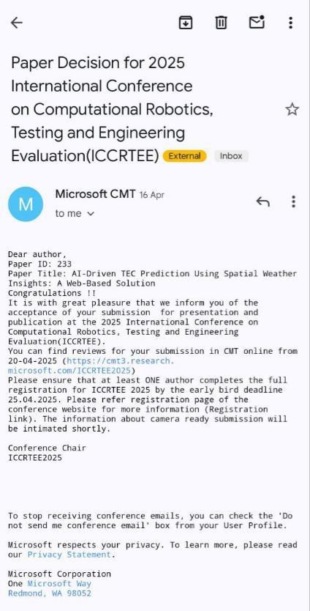
Research Paper: Accepted

Slide 13
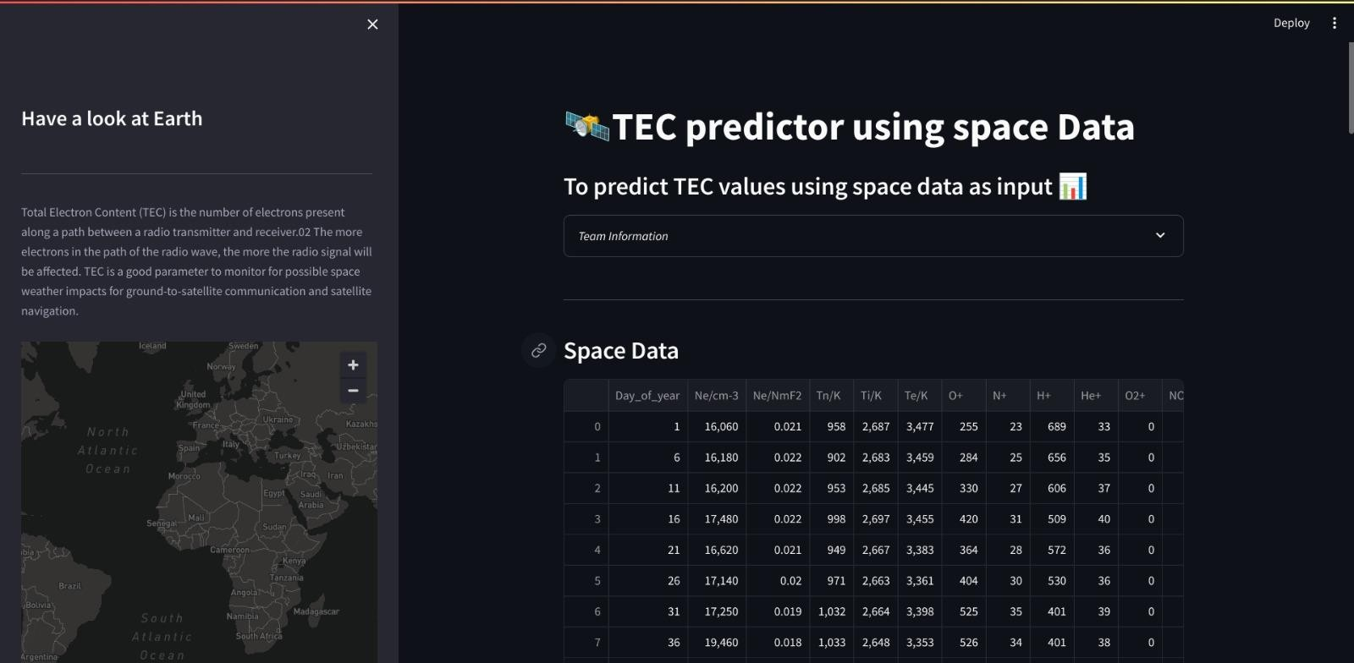

Project Status
Our project is completed and the progress is reflected in the screenshots provided below.

Slide 14
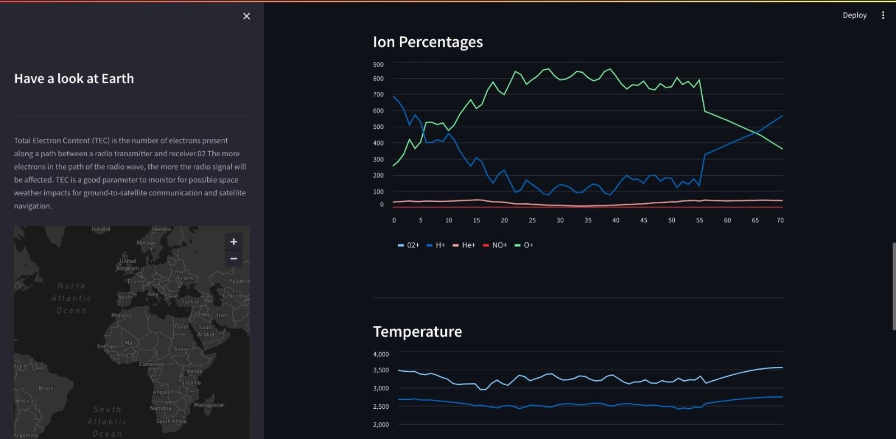

Slide 15
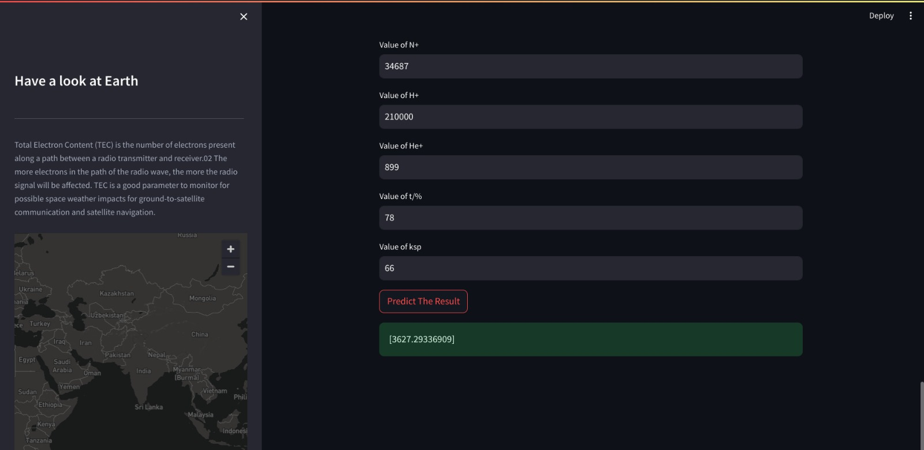

Slide 16
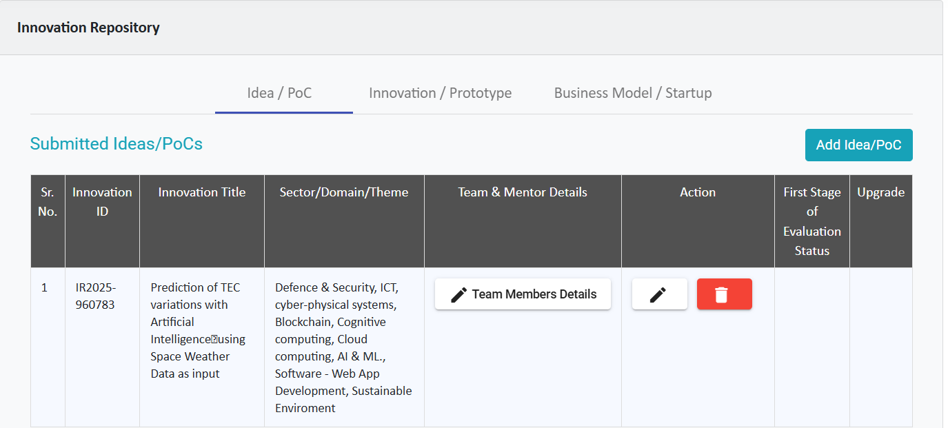
Yukti Portal Proof

Slide 17
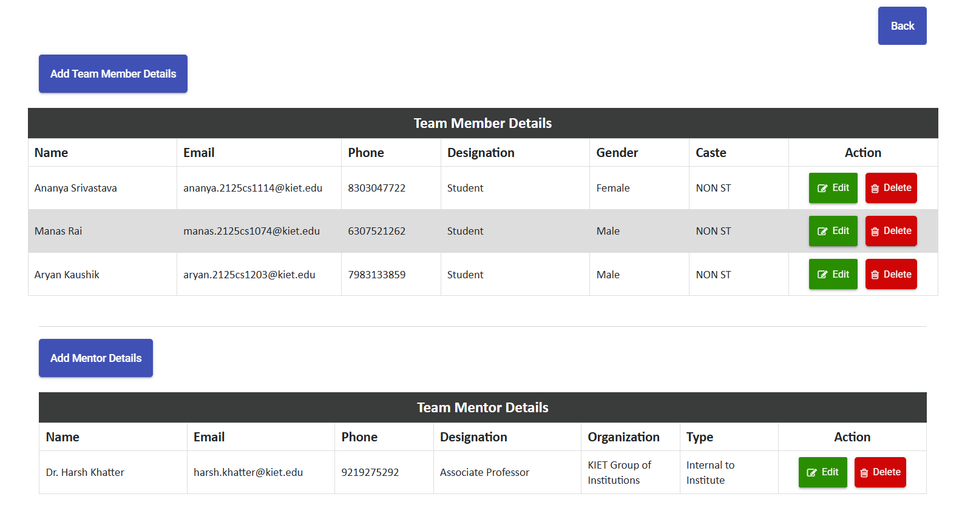
Yukti Portal Proof

Slide 18
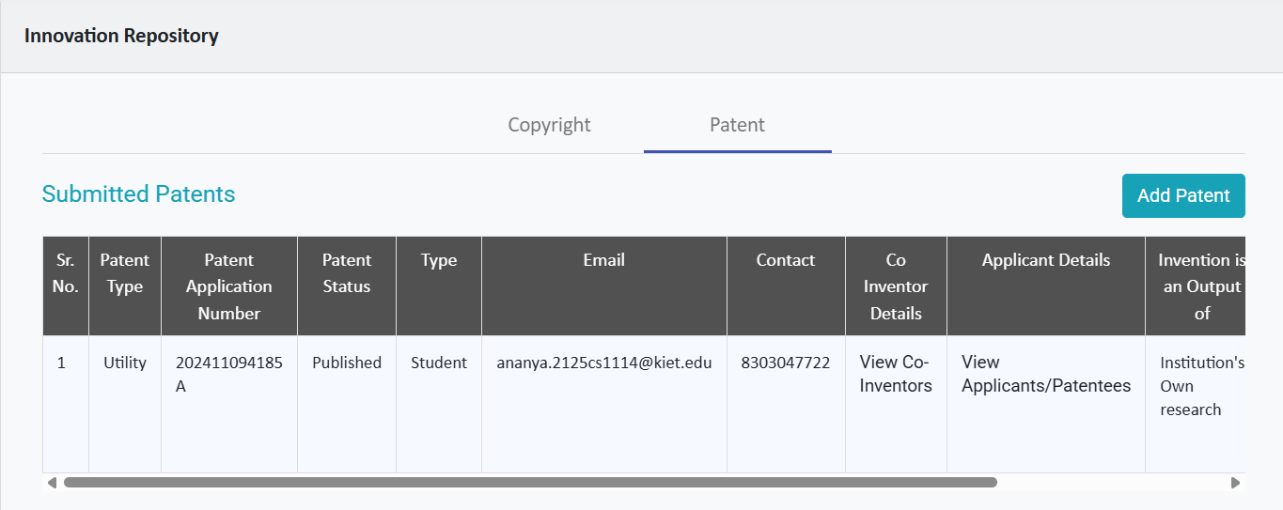
Yukti Portal Proof

Slide 19
References
https://omniweb.gsfc.nasa.gov/
https://www.swpc.noaa.gov/
https://wdc.kugi.kyoto-u.ac.jp/wdc/Sec3.html
https://igs.org/data/
https://deepblue.lib.umich.edu/bitstream/handle/2027.42/163558/swe21083_am.pdf?sequ ence=1
https://ieeexplore.ieee.org/document/10005062
https://www.mdpi.com/2073-4433/13/11/1939

